Slide 1
Project 2 Home prices prediction – Ames, IOWA
General Assembly – DSI 9
Gabriel Perez Prieto

Slide 2


Agenda
Problem Statement
Data Cleaning
EDA ( Exploratory Data Analysis )
Feature Selection / Engineering
Model – Linear Regression
Regularization
Next Steps

Slide 3
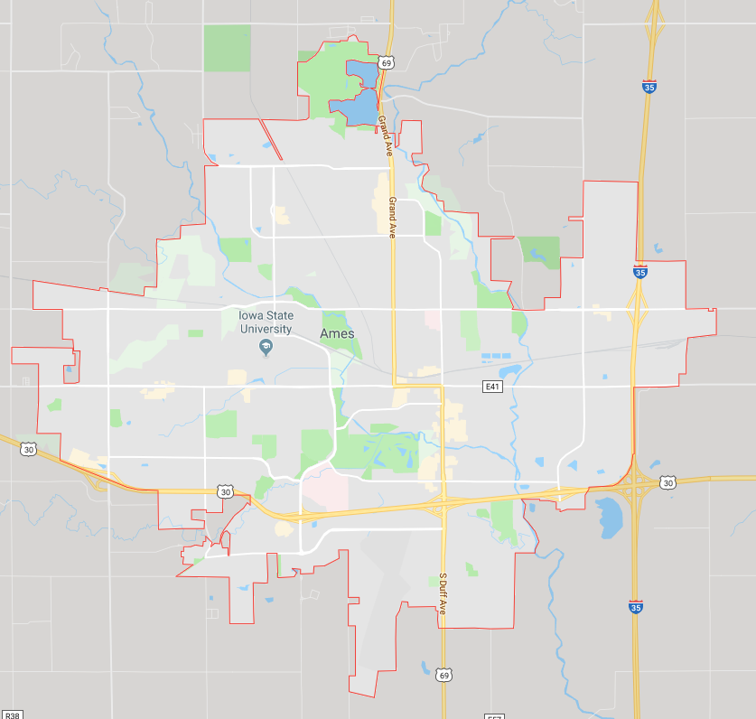

Problem Statement
Predict Home Prices in Ames, Iowa
Best model possible to predict prices

Slide 4
Data cleaning
Convert qualitative columns into quantitative.
Scores for Ex, Gd, TA, Fa, Po etc → 4, 3, 2, 1, 0
Null Values
Fill null values with the median of values for each column
Check for Duplicate Values

Slide 5
Eda – Exploratory data analysis
Data Description:
2050 Rows – Sold Houses
81 Columns – House Features
Data from 2007 - 2010
Target Variable – Price:
Mean = $ 181k
Median = $ 162k

Slide 6
Eda – Heatmap
Correlation > 0.5 with Target Variable

Slide 7
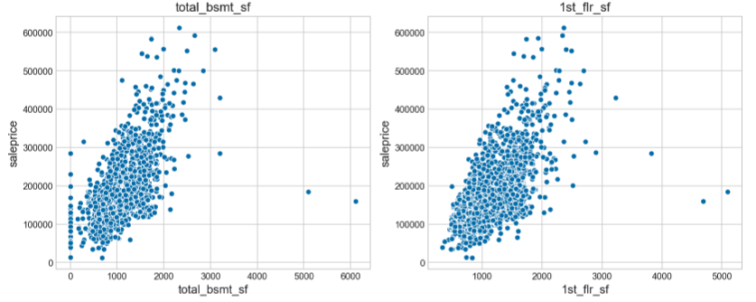
Eda – Scatterplots
Quantitative Variables:
Detect Outliers and Possible Features

Slide 8
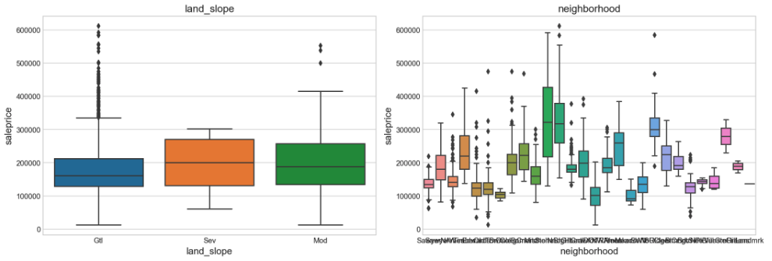
Eda – boxplots
Qualitative Variables:
Detect Outliers and Possible Features

Slide 9
Feature Selection / engineering
High Correlation with Target:
Interaction Terms
Total Area of the House:
df['total_area’] = df['total_bsmt_sf’] + df['1st_flr_sf'] + df['2nd_flr_sf'] + df['gr_liv_area'] + df['garage_area']
Polynomial Features:
Numerical Variables - Correlation with Target > 0.80
Dummies:
Nominal Variables with High Variance

Slide 10
Model_1 – Linear regression
Normalize Prices :
Better Model Fit
Model Performance:
49 Features
R2 Score w/ Ridge:
Train Data: 0.878
Test Data: 0.895
RMSE: 0.145
Kaggle Score: 24,001

Slide 11
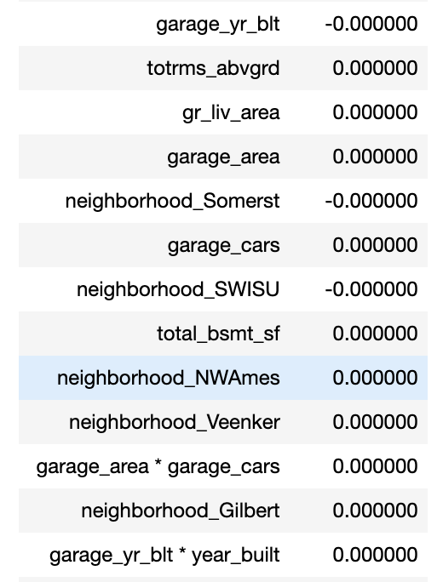
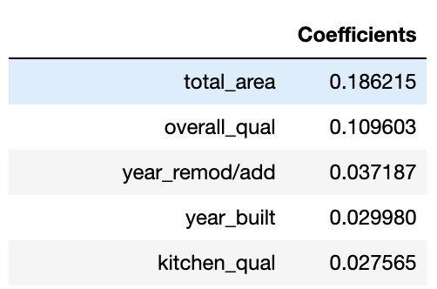
Regularization
Ridge / Lasso
Model was not overfit
Slight improve on Score
LlLassoCV Coefficients

Slide 12
Model_2 – Linear regression
Normalize Prices:
Better Model Fit
Model Performance:
1850 Features
R2 Score w/ Lasso:
Train Data: 0.923
Test Data: 0.963
RMSE: 0.094
Kaggle Score: 19,200

Slide 13
Next Steps and Model Improvement
Incorporate External Data:
Real Estate Trends
Missing Data:
Imputation – How to be more effective?
Outliers:
Better Analysis – When to remove?
Feature Engineering:
Techniques to create and select best features for the model

Slide 14
Thank you !
Questions ?

